Slide 1
Cyber security internship
Assignment-1

Slide 2
What is cyber security?
Cyber security is an protecting security, Cyber refers to Technology and security refers to protection .It is all about protecting computers, networks and data from unauthorized access. Types Of Cyber Security Attacks: Active Attack & Passive Attack 1. Active Attack: when someone deliberately tries to gain unauthorized access to a computer System or network. They might try to steal information, distrupt services or even also modify data. 1.Man-in-the-middle attack 2.spoofing 3. Dos attack 4. Phishing attack 5. Replay attack

Slide 3
Passive Attack
Passive Attack we can see data what’s happening but we cant change it. 1.Computer Surveillance: monitoring of computer systems and activities to ensure security prevent unauthorized access. 2. Network Surveillance :network traffic to detect and prevent security threats and maintain the confidentiality and security o sensitive information. 3. Wire Tapping: interception and monitoring of electronic communications for intelligence gathering or evidence

Slide 4
HACKERS CATEGORIES
1. Black Hat Hacker: These are the bad guys of hacking world. They use their skills to break into computer systems, networks, devices without permission. 2.White Hat Hacker: These are good guys of hacking world. They find vulnerabilities in computer systems, networks devices with permission. They help identitfy weakness. 3.Grey Hat Hacker: Both black hat hackers and white hat hackers.

Slide 5
Essential Terminologies :
1.malware:it can be used to steal sensitive information, damage computer systems, spread to other computers or hold data and systems hostage. 2.IP Address: IP address is a unique numerical label used to identify and locate devices on a network. 3. Phishing: Type of social engineering attack where attackers trick individuals into revealing sensitive information. 4.Firewall: System that monitors and controls incoming and outgoing network traffic based on predetermined security rules,
5.Social Engineering: It refers to the use of psychological manipulation and deception. Tactics to trick individuals into revealing sensitive information. 6. Ransomware:it type of malicious software that encrypts a victims files and demands payment in exchange for the decryption key. 7. Virtual Private Network: It is a secured encrypted connection between a device and a remote server that allows users to securely access the internet and protect their online activity and data from being monitored and intercepted.
8. Pen Testing: To evaluate the security of the system and identify vulnerabilities that could be exploaited by malicious actors.
9.Antivirus: Software designed to detect prevent and remove malicious software.

Slide 6
Introduction To Networking
►Client Sever Architecture: A client server is a way for computers to work together/(communication). The client requests information from the server. The server responds to the clients requests and provides the the requested information

Slide 7
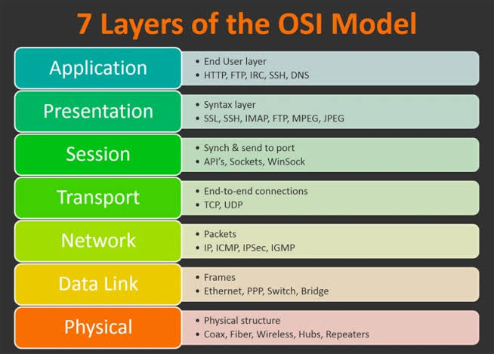
OSI model

Slide 8
OSI model
Application Layer: The Application layer is the top layer of the OSI model.its closest to the user –application. The user facing software directly interacts with the applications layer through sharing, msg handling or data base access. Proocols :Http, FTP, SMTP. Presentation layer: The P.L is about data translation and formatting. In this layer, protocols things like encryption, decryption,compression and decompression. The main goal of P.L is transform data. Session Layer: The session layer handles the communication between two oг more computers, protocols are to create a session b/w entities. The S.L handles the connection and authentication b/w a client or server. Transport Layer: Transport layer is to accept data from the S.L.split it up into small units if need be, pass these to the n/w layer and ensure that all the poeces arrive correctly at other layer. Network Layer: The N/L converts the received data into data packets for
sharing communication channel. Data link layer: The data link layer is responsible for transferring messgaes from a given node to all other nodes in n/w. . Organizes bits into frames Physical Layer: It describes the way data is actually transmitted on the n/w medium.

Slide 9
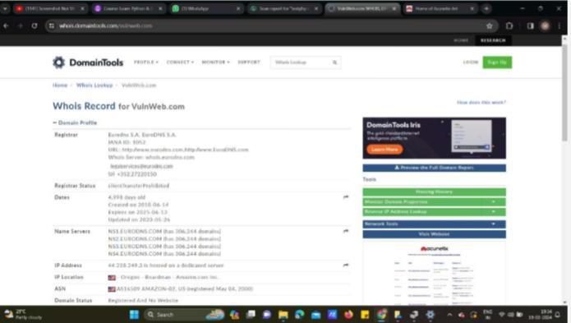
DOMAIN TOOLS
WHO IS RECORD FOR VULNWEB.COM

Slide 10
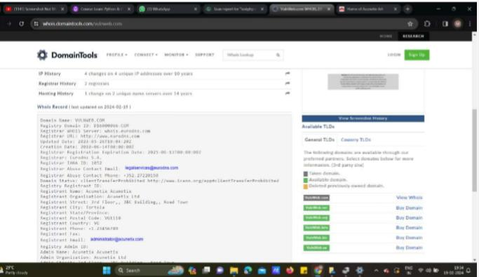
IP HISTORY REGISTRATION HISTORY HOSTING HISTORY

Slide 11
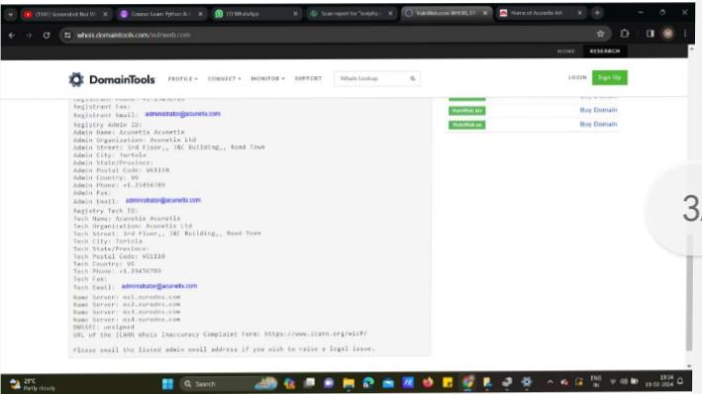
ADDRESS

Slide 12
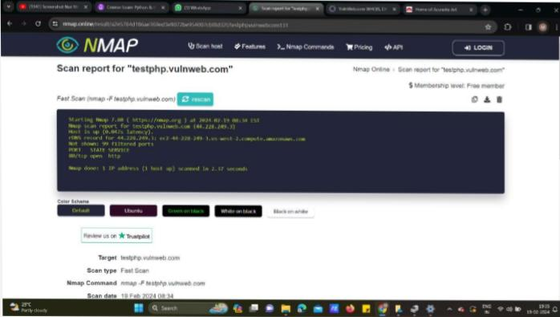
Scan host

Slide 13
PASSWORD CRACKING
A password crack is a process of identifying a forgotten or unknown password to a computer or network resource by means of an application program. A threat actor can also use it to gain unauthorized access to resources.

Slide 14
OWASP TOP 10 WEB APPLICATION SECURITY RISKS
A01:2021:Broken Access Control A02:2021-Cryptographic Failures A03:2021-injection A04:2021-Insecure Design A05:2021-Security Misconfiguration. A06:2021-Vulnerable and outdated components A07:2021-Identification and Authentication Failures A08:221-Software and Data integrity Failures A09:2021-Security Logging and monitoring failures ►A10:Server-side Request Forgery

Slide 15
Top 10 Web Application Security Risks
Top 10 Web Application Security Risks Open Web Application Security Project (OWASP) The OWASP Top 10 is a standard awareness document for developers and web application security.
There are three new categories, four categories with naming and scoping changes, and some consolidation in the Top 10 for 2021.

Slide 16
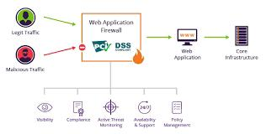
Introduction To Web Applications... How web applications On work

Slide 17
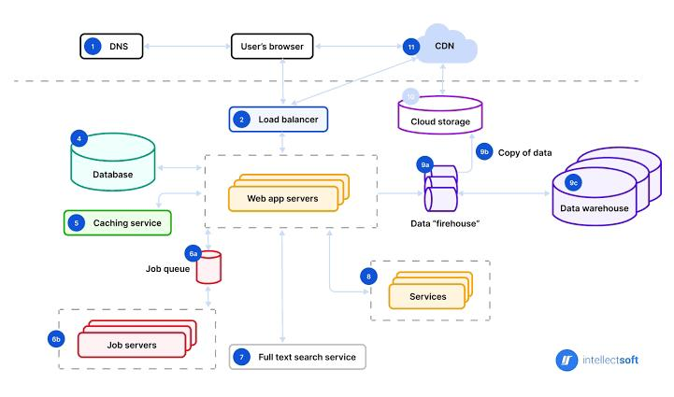
Web applications architecture

Slide 18
Web services
►Web services is a type of software system that enables communication between different applications/components over the internet. They use standaralized proticols and data formats such as HTTP,XML and ISON to allow different systems to exchange data and functionality in a platform-independent manner

Slide 19
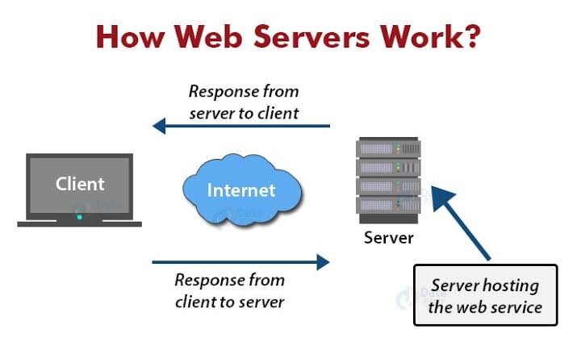
Web Server work

Slide 20
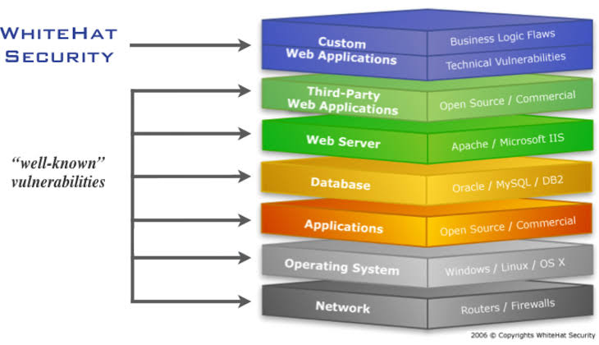
VULNERABILITY STACK

Slide 21
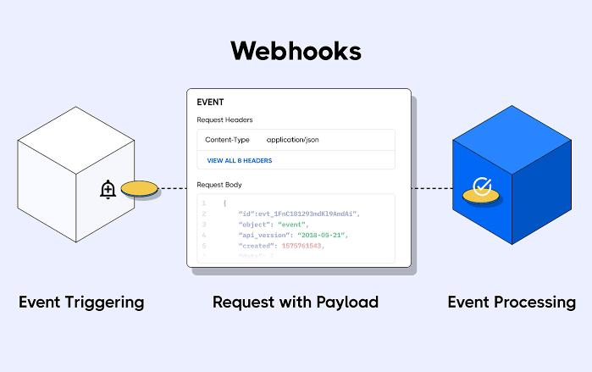
What is webhook
►Webhooks are a way for web appliactions to provide real time notifications to other applications or services by sending HTTP request to a specialized URL whenever a specific event occurs. Ex: A webhook could be used to notify a third-party Service whenever a new order isplaced on an e-commerce website.

